Slide 1
Mathematics of Cryptography
Dr. B C Dhara
Department of Information Technology
Jadavpur University

Slide 2
Objectives
Review integer arithmetic, divisibility, finding the greatest common divisor using Euclidean algorithm
Use of extended Euclidean algorithm to solve linear Diophantine equations, linear congruent equations, and find the multiplicative inverses
Importance of modular arithmetic and the modulo operator
Review matrices and operations on residue matrices
To solve a set of congruent equations using residue matrices
B C Dhara, Dept. of IT, JU

Slide 3
INTEGER ARITHMETIC
In integer arithmetic, we use a set and a few operations, they are reviewed here to create a background for modular arithmetic
Topics to be discussed
  Set of Integers
  Binary Operations
  Integer Division
  Divisibility
  Linear Diophantine Equations
B C Dhara, Dept. of IT, JU

Slide 4

Set of Integers
The set of integers, denoted by Z, contains all integral numbers (with no fraction) from negative infinity to positive infinity
B C Dhara, Dept. of IT, JU

Slide 5
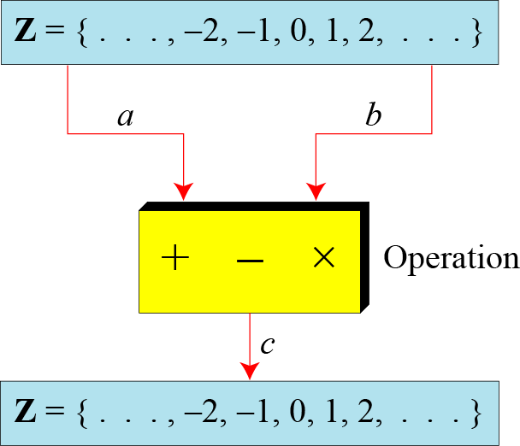
Binary Operations
In cryptography, we are interested in three binary operations applied to the set of integers. A binary operation takes two inputs and creates one output.
B C Dhara, Dept. of IT, JU

Slide 6
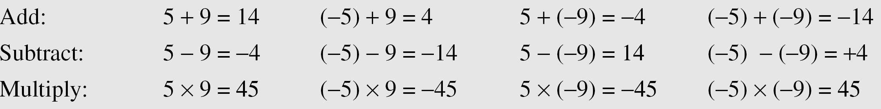
Binary Operations (Contd…)
The following shows the results of the three binary operations on two integers. Because each input can be either positive or negative, we can have four cases for each operation.
B C Dhara, Dept. of IT, JU

Slide 7
Integer Division
In integer arithmetic, if we divide a by n, we can get q and r . The relationship between these four integers can be shown as
‘a’ is dividend, ‘q’ is quotient, ‘n’ is divisor and ‘r’ is remainder
This is not an operation as get two outputs ‘q’ and ‘r’
  This is called division relation
a = q × n + r
B C Dhara, Dept. of IT, JU

Slide 8
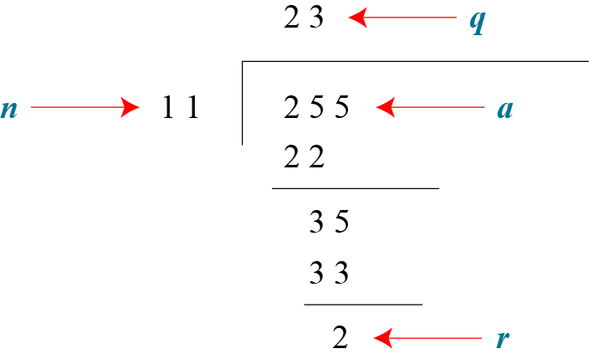
Integer Division (Contd…)
Assume that a = 255 and n = 11. We can find q = 23 and R = 2 using the division algorithm
In cryptography two restrictions imposed:
Divisor be a positive (n>0)
Remainder be a nonnegative integer (r ≥ 0)
B C Dhara, Dept. of IT, JU

Slide 9

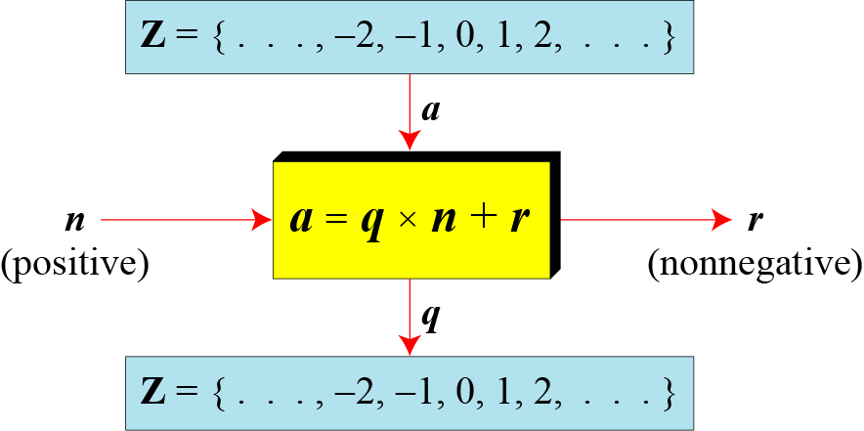
Division algorithm for integers
B C Dhara, Dept. of IT, JU

Slide 10
Division algorithm for integers (contd…)
When we use a computer or a calculator, r and q are negative when a is negative.
How can we apply the restriction that r needs to be positive?
The solution is simple, we decrement the value of q by 1 and we add the value of n to r to make it positive.
B C Dhara, Dept. of IT, JU

Slide 11
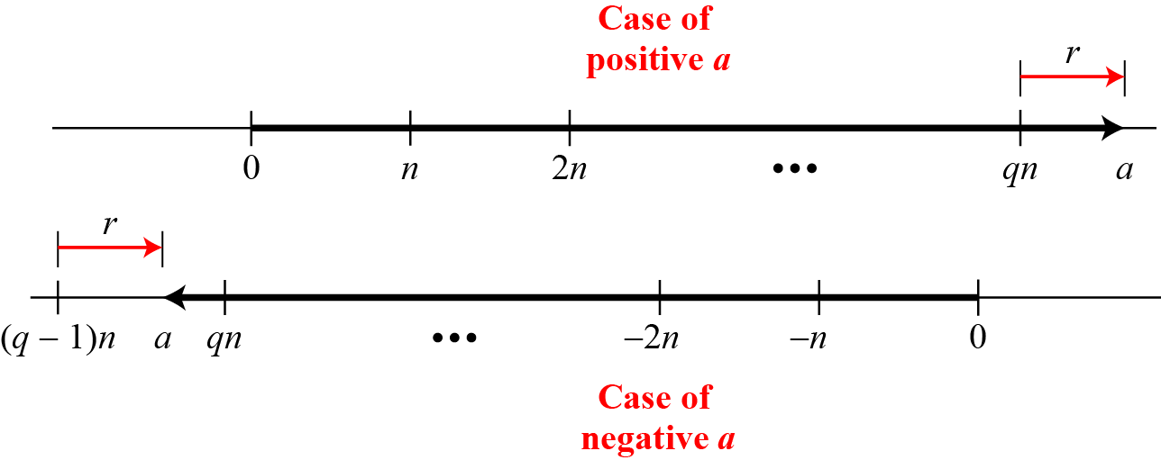
Graph of division algorithm
B C Dhara, Dept. of IT, JU

Slide 12

Divisibility
If a is not zero and we let r = 0 in the division relation, we get
a = q × n
If the remainder is zero, n|a (n divides a)
If the remainder is not zero, (n does not divides a)
B C Dhara, Dept. of IT, JU

Slide 13
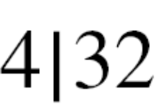
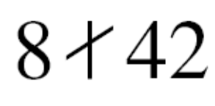
Divisibility (Contd…)
The integer 4 divides the integer 32 because 32 = 8 × 4. We show this as
b. The number 8 does not divide the number 42 because
42 = 5 × 8 + 2. There is a remainder, the number 2, in the equation. We show this as
B C Dhara, Dept. of IT, JU

Slide 14
Divisibility (Contd…)
Property 1: if a|1, then a = ±1
Property 2: if a|b and b|a, then a = ±b
Property 3: if a|b and b|c, then a|c
Property 4: if a|b and a|c, then
a|(m × b + n × c), where m
and n are arbitrary integers
B C Dhara, Dept. of IT, JU

Slide 15
Divisibility (Contd…)
Since 3|15 and 15|45 ➔ 3|45 (by 3rd property)
Since 3|15 and 3|9 ➔ 3|(15×2+9 ×4) i.e., 3|66 (by 4th property)
B C Dhara, Dept. of IT, JU

Slide 16
Divisibility (Contd…)
Fact 1: The integer 1 has only one
divisor, itself.
Fact 2: Any positive integer>1 has at least two divisors, 1 and itself (but it
can have more).
B C Dhara, Dept. of IT, JU

Slide 17
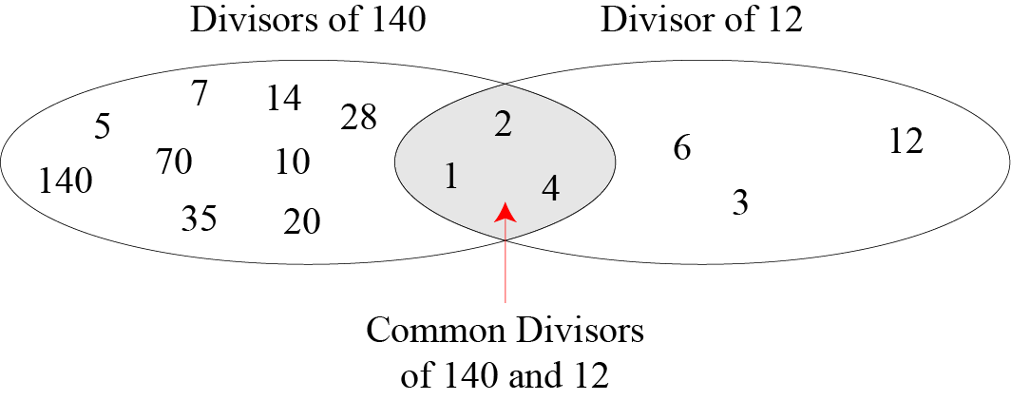
Common divisors of two integers
B C Dhara, Dept. of IT, JU

Slide 18
Greatest Common Divisor
The greatest common divisor of two positive integers is the largest integer that can divide both integers.
Euclidean Algorithm
Fact 1: gcd (a, 0) = a
Fact 2: gcd (a, b) = gcd (b, r), where r is
the remainder of dividing a by b
B C Dhara, Dept. of IT, JU

Slide 19
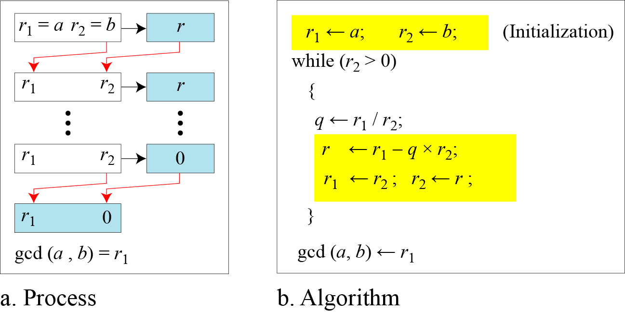
Euclidean Algorithm
When gcd (a, b) = 1, we say that a and b are relatively prime.
B C Dhara, Dept. of IT, JU

Slide 20
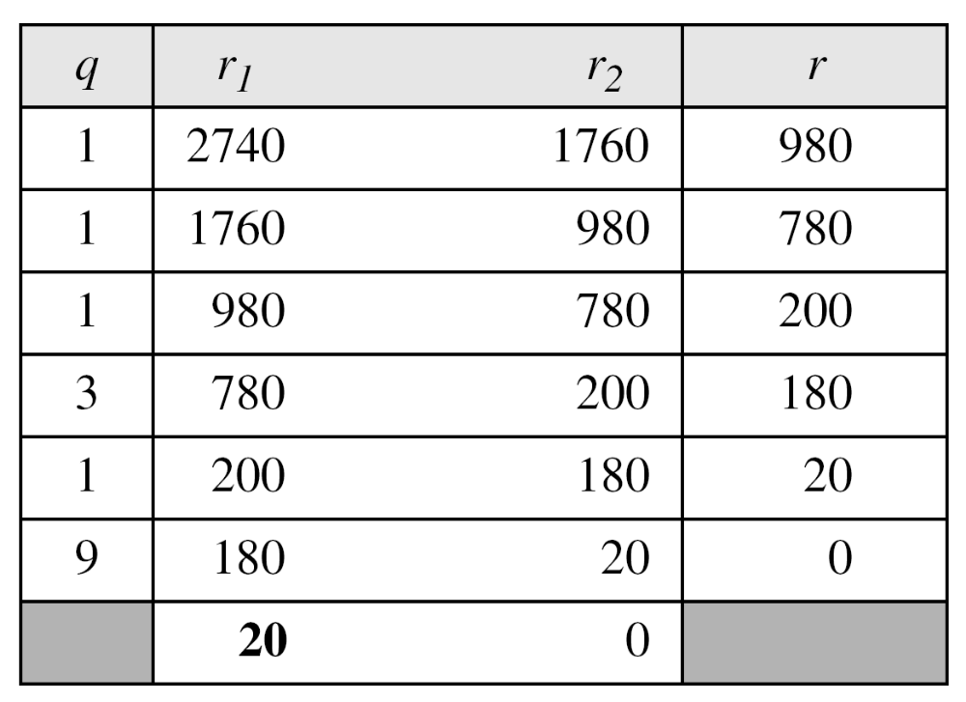
Euclidean Algorithm: example
Find the greatest common divisor of 2740 and 1760.
B C Dhara, Dept. of IT, JU

Slide 21
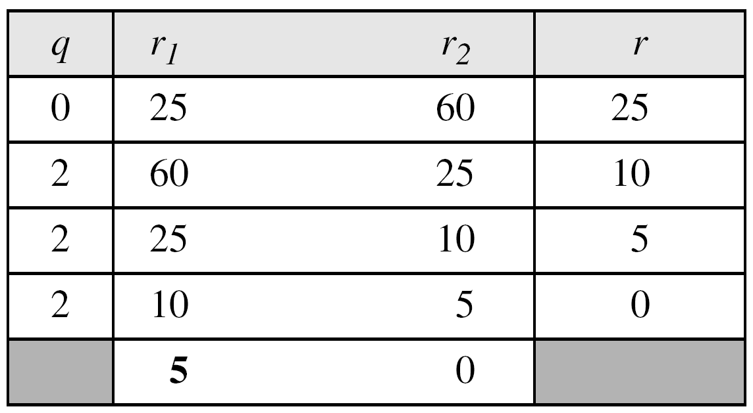
Euclidean Algorithm: example
Find the greatest common divisor of 25 and 60
B C Dhara, Dept. of IT, JU

Slide 22

Extended Euclidean algorithm
Property 4 of divisibility: if a|b and a|c, then a|(m × b + n × c), where m and n are arbitrary integers
Given two integers a and b, we often need to find other two integers, s and t, such that
The extended Euclidean algorithm can calculate the gcd (a, b) and at the same time calculate the value of s and t.
B C Dhara, Dept. of IT, JU

Slide 23
Extended Euclidean algorithm (contd…)
Finding the gcd(81, 57) by the Euclidean Algorithm:
81 = 1(57) + 24
57 = 2(24) + 9
24 = 2(9) + 6
9 = 1(6) + 3
6 = 2(3) + 0
3 = 9 -1(6) [6 = 24 - 2(9)]
3 = 9 - 1(24 - 2(9))
= 3(9) - 1(24) [9 = 57 - 2(24)]
3 = 3( 57 - 2(24)) - 1(24)
= 3(57) - 7(24) [24 = 81 - 1(57)]
3 = 3(57) - 7( 81 - 1(57))
= 10(57) -7(81)
B C Dhara, Dept. of IT, JU

Slide 24
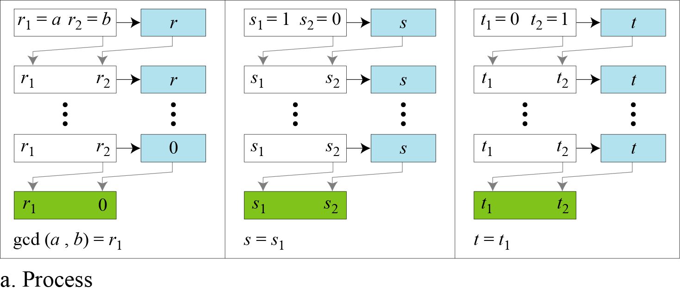
Extended Euclidean algorithm (Contd…)
B C Dhara, Dept. of IT, JU

Slide 25
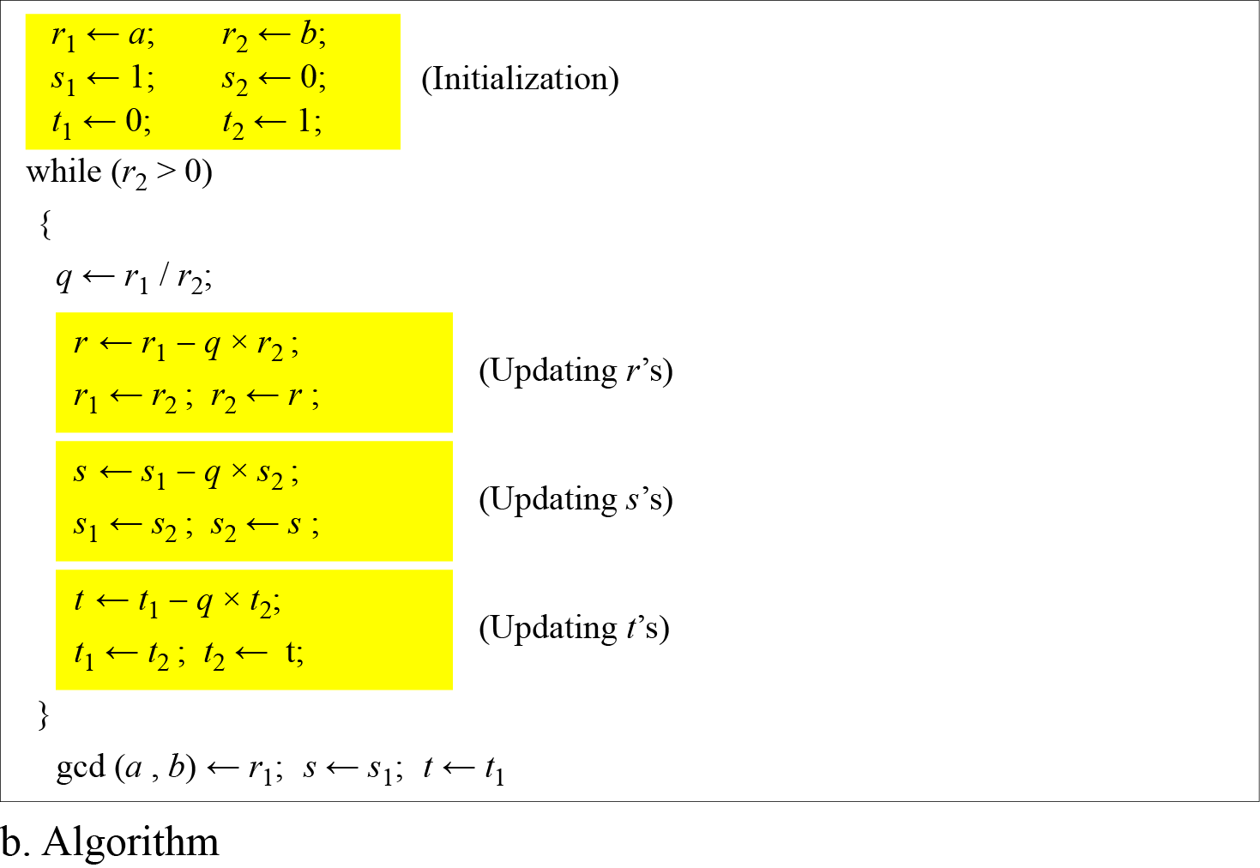
Extended Euclidean algorithm (Contd…)
B C Dhara, Dept. of IT, JU

Slide 26
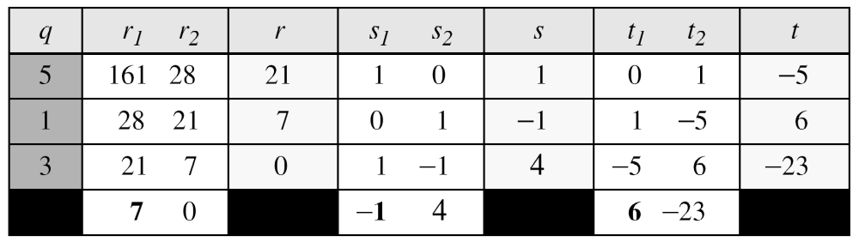
Extended Euclidean algorithm (Contd…)
Given a = 161 and b = 28, find gcd (a, b) and the values of s and t.
We get gcd (161, 28) = 7, s = −1 and t = 6.
  161×-1+28×6=7
B C Dhara, Dept. of IT, JU

Slide 27
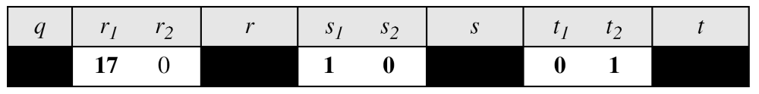
Extended Euclidean algorithm (Contd…)
Given a = 17 and b = 0, find gcd (a, b) and the values of s and t
We get gcd (17, 0) = 17, s = 1, and t = 0
B C Dhara, Dept. of IT, JU

Slide 28
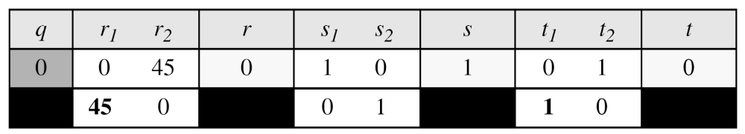
Extended Euclidean algorithm (Contd…)
Given a = 0 and b = 45, find gcd (a, b) and the values of s and t
We get gcd (0, 45) = 45, s = 0, and t = 1
B C Dhara, Dept. of IT, JU

Slide 29
Linear Diophantine Equation
A linear Diophantine equation of two variables is ax + by = c.
This equation has either no solution or infinite solutions
Let, d= gcd(a,b)
  If d divides c, then infinite solution (one particular solution and rest, general)
  Otherwise, no solution
B C Dhara, Dept. of IT, JU

Slide 30
Linear Diophantine Equation (contd…)
Particular solution
ax + by = c ➔ a₁x+b₁y = c₁ [divided by d]
Solve a₁s+b₁t = 1 for s and t using extended Euclidean algorithm
a₁s+b₁t = 1 ➔ (a/d)s + (b/d)t =1
➔a(c/d)s+b(c/d)t = c
Particular solution:
x₀ = (c/d)s and y₀ = (c/d)t
B C Dhara, Dept. of IT, JU

Slide 31
Linear Diophantine Equation (contd…)
Particular solution (x₀, y₀), so
ax₀+by₀ = c
➔ a(x₀+k(b/d))+b(y₀ –k(a/d))= c
or
➔ a(x₀-k(b/d))+b(y₀ +k(a/d))= c
General solutions:
x = x₀ + k (b/d) and y = y₀ − k(a/d)
or
x = x₀ - k (b/d) and y = y₀ + k(a/d)
where k is an integer
B C Dhara, Dept. of IT, JU

Slide 32
Linear Diophantine Equation: example
Find the particular and general solutions to the equation 21x + 14y = 35
  [3x+2y=5 ➔ 3x+2y=1 (1, -1)]
  Particular solution:
  x₀ = (c/d)s = 35/7*1=5;
  y₀ = (c/d)t = 35/7*(-1)=-5;
  General solution:
x= 5+k*14/7= 5+2k
y=-5-k*21/7=-5-3k
x= 5-k*14/7= 5-2k
y=-5+k*21/7=-5+3k
or
B C Dhara, Dept. of IT, JU

Slide 33
Example linear Diophantine
For example, imagine we want to cash a Rs. 100 check and get some Rs. 20 and some Rs. 5 bills. We have many choices, which we can find by solving the corresponding Diophantine equation 20x + 5y = 100
Since d = gcd (20, 5) = 5 and 5 | 100, the equation has an infinite number of solutions, but only a few of them are acceptable in this case
The general solutions with x and y nonnegative are (0, 20), (1, 16), (2, 12), (3, 8), (4, 4), (5, 0)
B C Dhara, Dept. of IT, JU

Slide 34
MODULAR ARITHMETIC
The division relationship (a = q × n + r) discussed in the previous section has two inputs (a and n) and two outputs (q and r).
In modular arithmetic, we are interested in only one of the outputs, the remainder r
Modular Operator
Set of Residues
Congruence
Operations in Z_{n}
Addition and Multiplication Tables
Different Sets
B C Dhara, Dept. of IT, JU

Slide 35
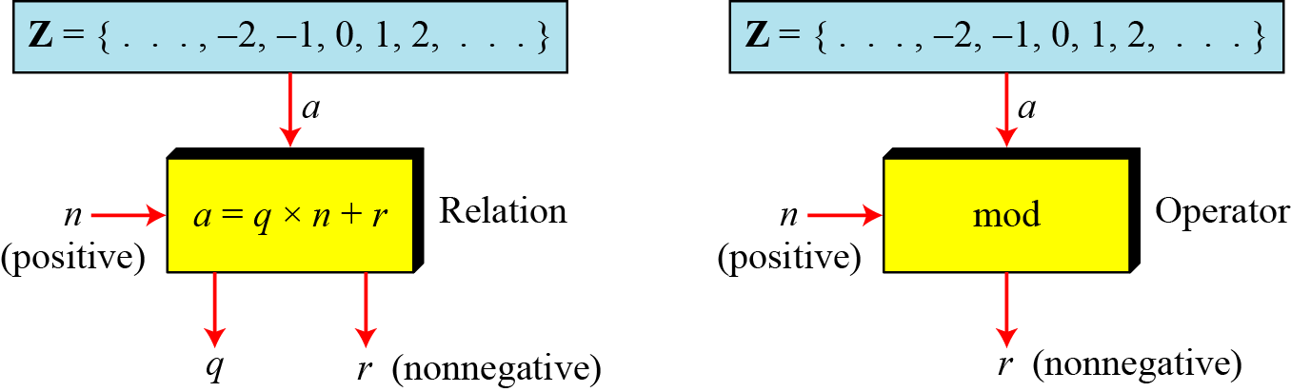
Modular Operator
The modulo operator is shown as mod. The second input (n) is called the modulus. The output r is called the residue.
Division algorithm and modulo operator
B C Dhara, Dept. of IT, JU

Slide 36
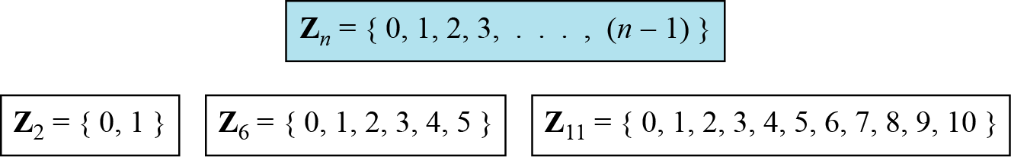
Set of Residues
The modulo operation creates a set, which in modular arithmetic is referred to as the set of least residues modulo n, or Z_{n}
Some Z_{n}
B C Dhara, Dept. of IT, JU

Slide 37
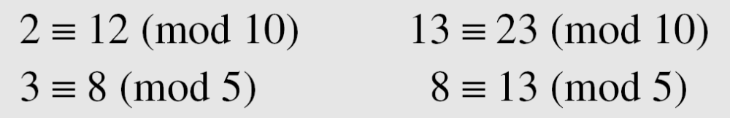
Congruence
Z → Z_{n}, is not one-to-one mapping
  Many members of Z map to one member of Z_{n},
  e.g., 2 mod 10=2, 12 mod 10=2, 22 mod 10=2
2, 12 and 22 are called congruent mod 10
To show that two integers are congruent, we use the congruence operator ( ≡ ). For example, we write:
B C Dhara, Dept. of IT, JU

Slide 38
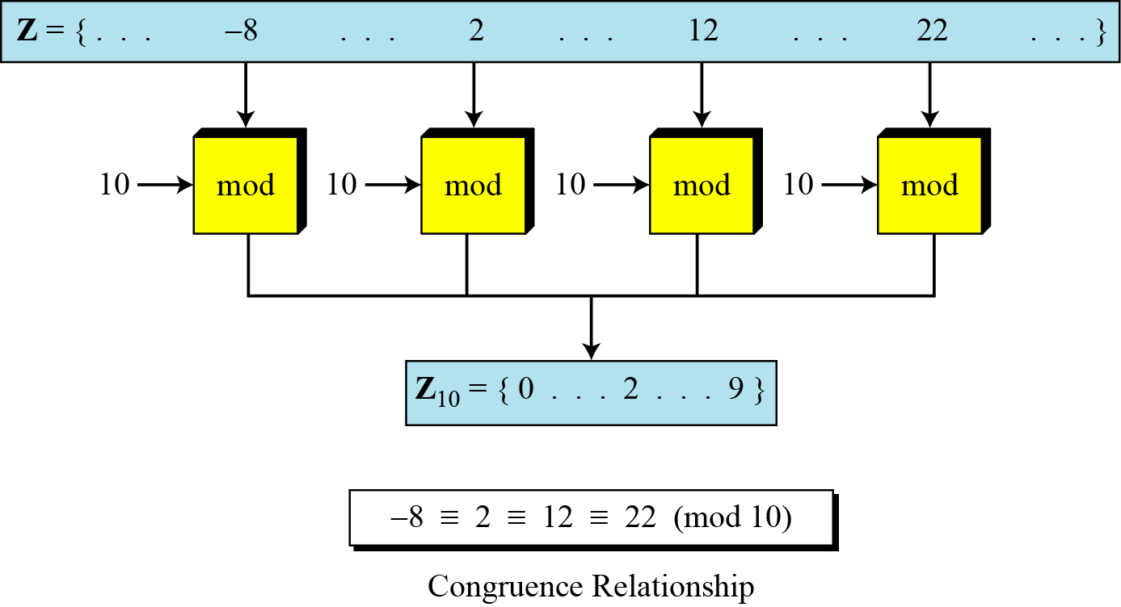
Congruence (contd…)
B C Dhara, Dept. of IT, JU

Slide 39
Congruence (contd…)
Congruence looks like equal operator, but there are difference:
  Equality operator maps a member of Z to itself
  Congruence operator maps a member from Z to Z_{n}
  Equality one-to-one mapping, congruence operator is many-to-one mapping
  (mod n) is used to indicate the destination set Z_{n}
B C Dhara, Dept. of IT, JU

Slide 40
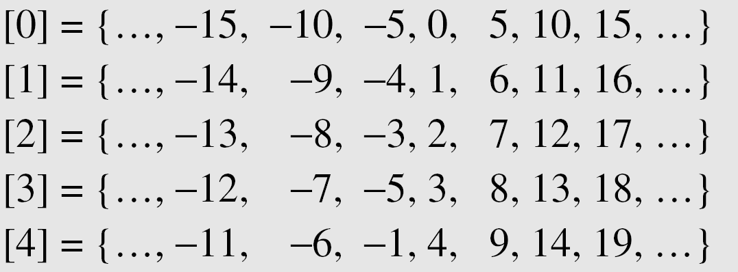
Residue Classes
A residue class [a] or [a]_{n} is the set of integers congruent modulo n.
  Set of all integers such that x ≡ a (mod n)
  Residue classes (mod 5)
B C Dhara, Dept. of IT, JU

Slide 41
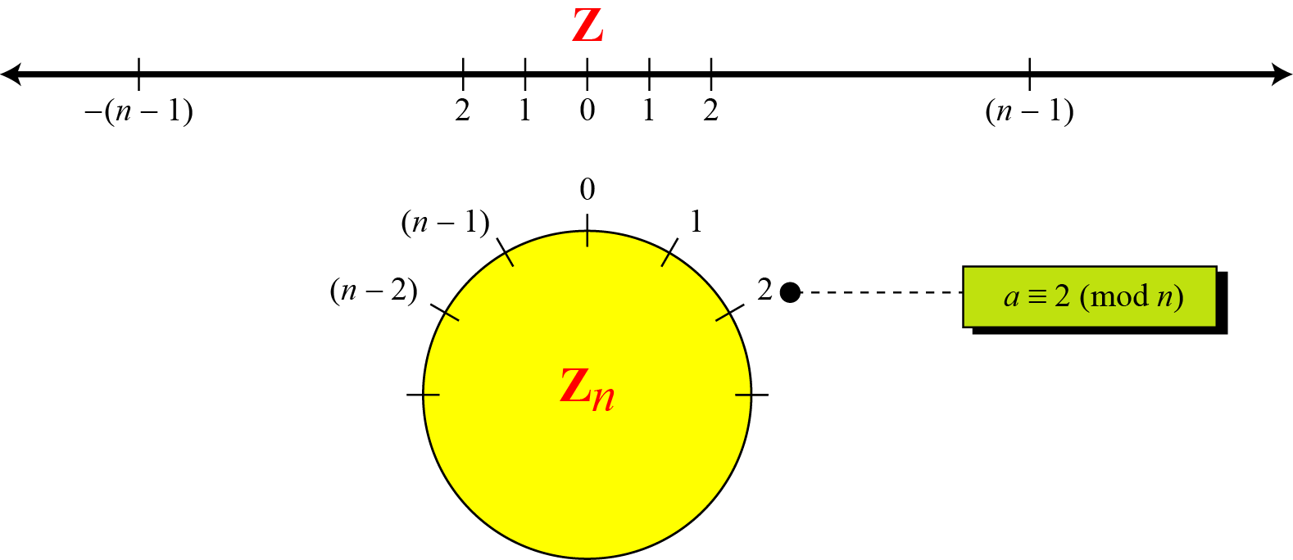
Comparison of Z and Z_{n} using graphs
B C Dhara, Dept. of IT, JU

Slide 42
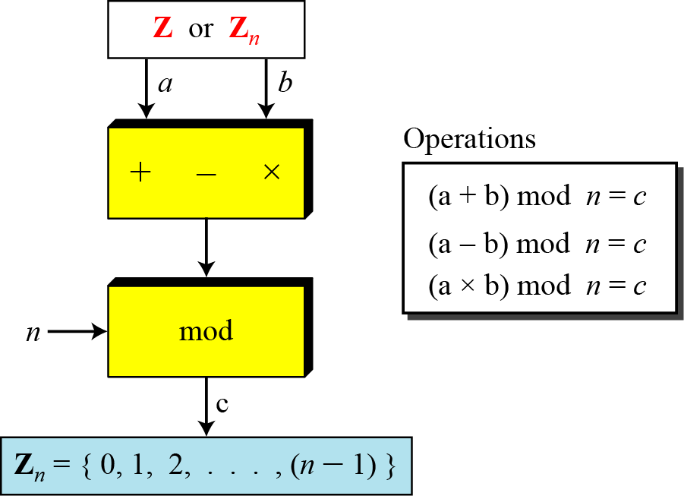
Operation in Z_{n}
The three binary operations (addition, subtraction and multiplication) for the set Z can also be defined for the set Z_{n}
  The result may need to be mapped to Z_{n} using the mod operator
B C Dhara, Dept. of IT, JU

Slide 43
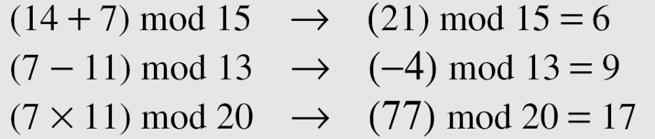
Operation in Z_{n} (contd…)
Perform the following operations (the inputs come from Z_{n}):
a. Add 7 to 14 in Z₁₅.
b. Subtract 11 from 7 in Z₁₃.
c. Multiply 11 by 7 in Z₂₀.
B C Dhara, Dept. of IT, JU

Slide 44
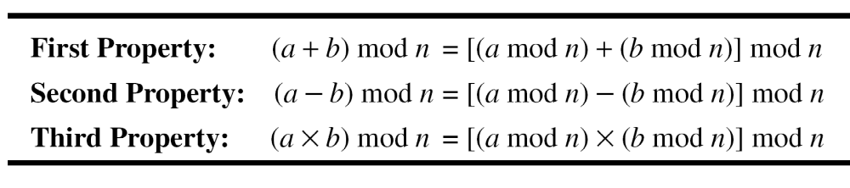
Properties of modular arithmetic
B C Dhara, Dept. of IT, JU

Slide 45
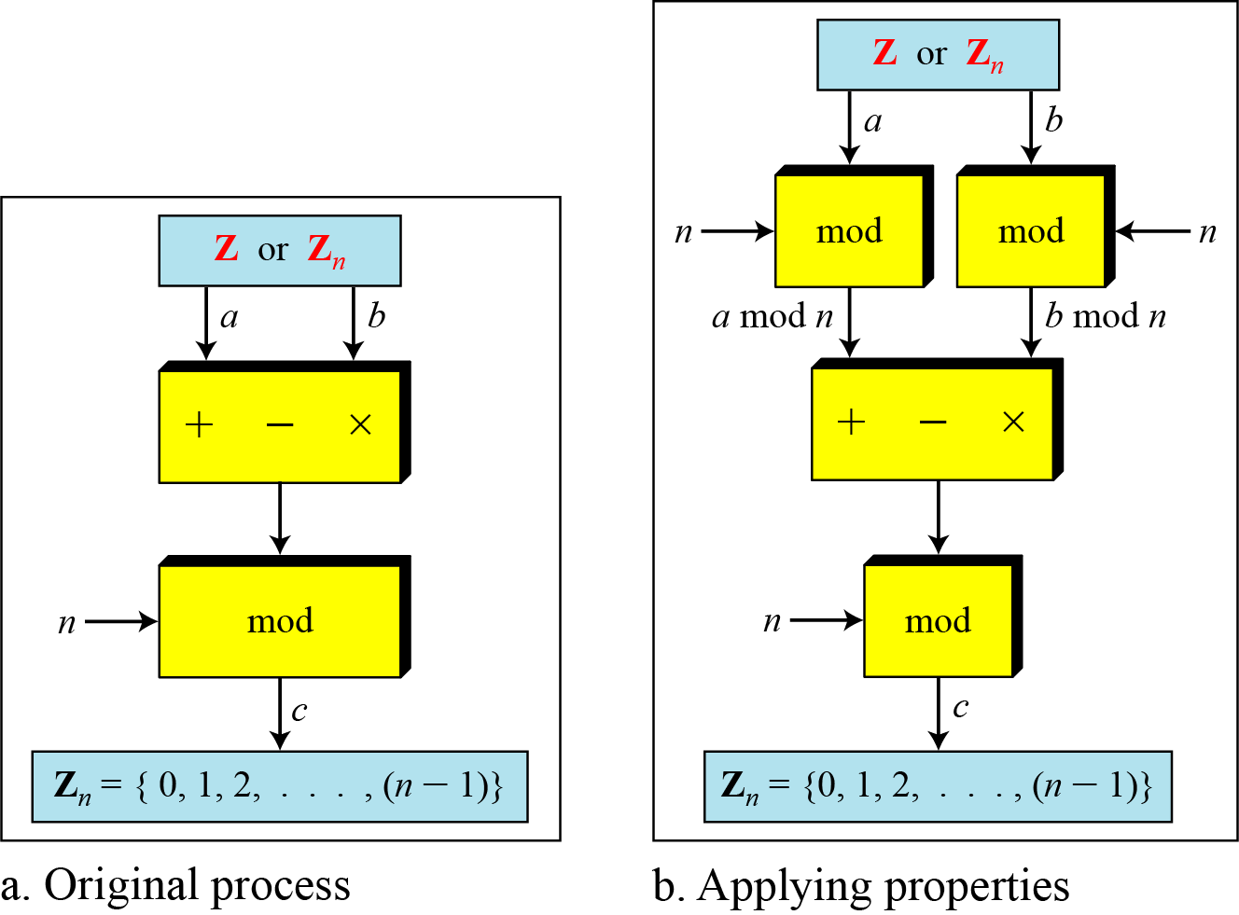
Properties of modular arithmetic (contd…)
B C Dhara, Dept. of IT, JU

Slide 46
Example
The following shows the application of the above properties:
(1723345 + 2124945) mod 11 = (8 + 9) mod 11 = 6
(1723345 −2124945) mod 16 = (8 − 9) mod 11 = 10
(1723345 × 2124945) mod 16 = (8 × 9) mod 11 = 6
11⁷ mod 13 ?
B C Dhara, Dept. of IT, JU

Slide 47
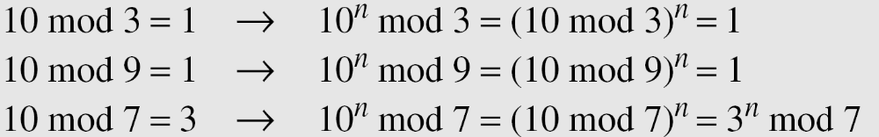
Example (contd…)
B C Dhara, Dept. of IT, JU

Slide 48
Inverse
When we are working in modular arithmetic, we often need to find the inverse of a number relative to an operation. We are normally looking for
  an additive inverse (relative to an addition operation) or
  a multiplicative inverse (relative to a multiplication operation)
B C Dhara, Dept. of IT, JU

Slide 49

Additive inverse
In Z_{n}, two numbers a and b are additive inverses of each other if
In modular arithmetic, each integer has an additive inverse. The sum of an integer and its additive inverse is congruent to 0 modulo n.
B C Dhara, Dept. of IT, JU

Slide 50
Additive inverse (contd…)
Find all additive inverse pairs in Z₁₀
The six pairs of additive inverses are (0, 0), (1, 9), (2, 8), (3, 7), (4, 6), and (5, 5).
B C Dhara, Dept. of IT, JU

Slide 51

Multiplicative inverse
In Z_{n}, two numbers a and b are the multiplicative inverse of each other if
In modular arithmetic, an integer may or may not have a multiplicative inverse
When it does, the product of the integer and its multiplicative inverse is congruent to 1 modulo n
B C Dhara, Dept. of IT, JU

Slide 52
Multiplicative inverse (contd…)
‘a’ has multiplicative inverse in Z_{n} if and only if gcd(n,a)=1
  ‘a’ and ‘n’ said to be relatively prime
B C Dhara, Dept. of IT, JU

Slide 53
Multiplicative inverse (contd…)
Find the multiplicative inverse of 8 in Z₁₀.
There is no multiplicative inverse because gcd (10, 8) = 2 ≠ 1. In other words, we cannot find any number between 0 and 9 such that when multiplied by 8, the result is congruent to 1
B C Dhara, Dept. of IT, JU

Slide 54
Multiplicative inverse (contd…)
Find all multiplicative inverses in Z₁₀
  There are only three pairs: (1, 1), (3, 7) and (9, 9). The numbers 0, 2, 4, 5, 6, and 8 do not have a multiplicative inverse
Find all multiplicative inverse pairs in Z₁₁
  We have six pairs: (1, 1), (2, 6), (3, 4), (5, 9), (7, 8), and (10, 10)
B C Dhara, Dept. of IT, JU

Slide 55
Multiplicative inverse (contd…)
The extended Euclidean algorithm finds the multiplicative inverses of b in Z_{n} when n and b are given and gcd (n, b) = 1
The multiplicative inverse of b is the value of t after being mapped to Z_{n}.
For number ‘b’ and ‘n’, we have s×n + b×t=gcd(n,b)
Incase of multiplicative inverse gcd(n,b)=1, So,
s×n + b×t=1
(s×n + b×t) mod n =1 mod n
[(s×n) mod n + (b×t) mod n] = 1 mod n
0+ (b×t) mod n=1 mod n
(b×t) mod n = 1
B C Dhara, Dept. of IT, JU

Slide 56
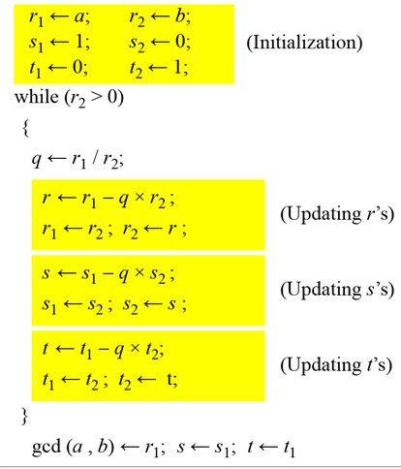
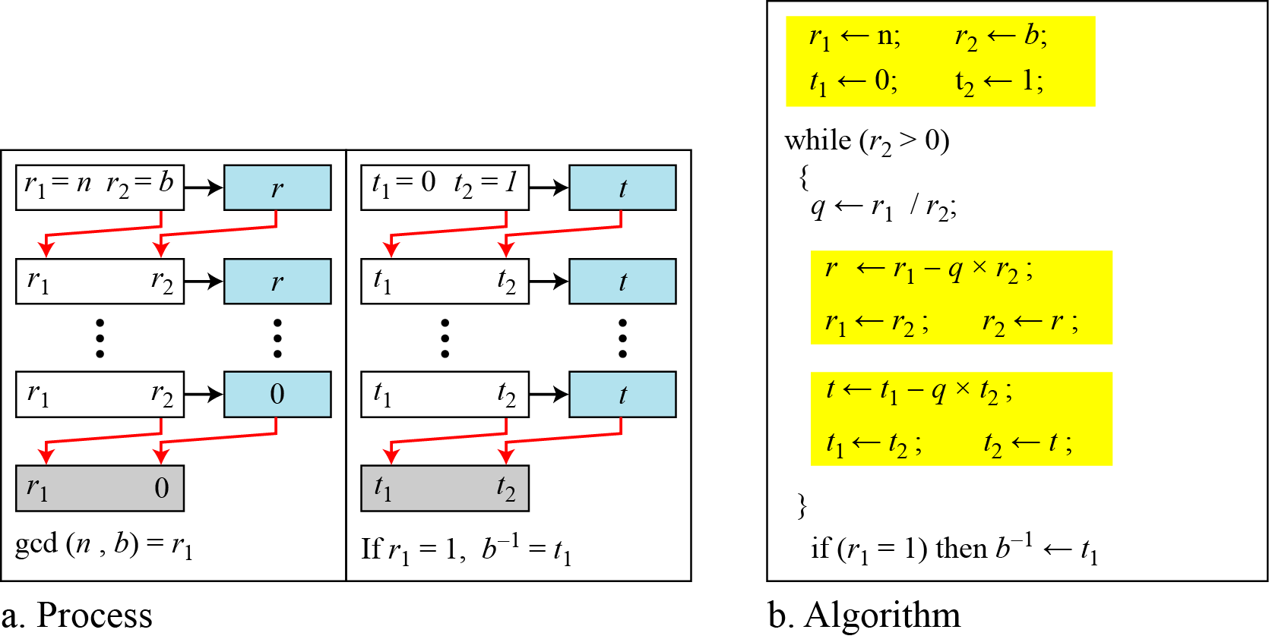
Extended Euclidean algorithm for multiplicative inverse
B C Dhara, Dept. of IT, JU

Slide 57
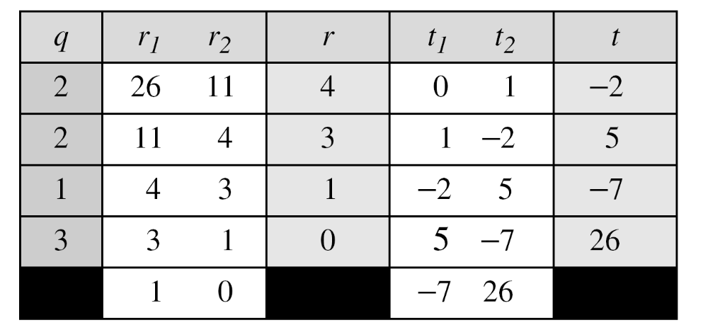
Extended Euclidean algorithm for multiplicative inverse (contd…)
Find the multiplicative inverse of 11 in Z₂₆.
The gcd (26, 11) is 1; the inverse of 11 is −7 or 19
B C Dhara, Dept. of IT, JU

Slide 58
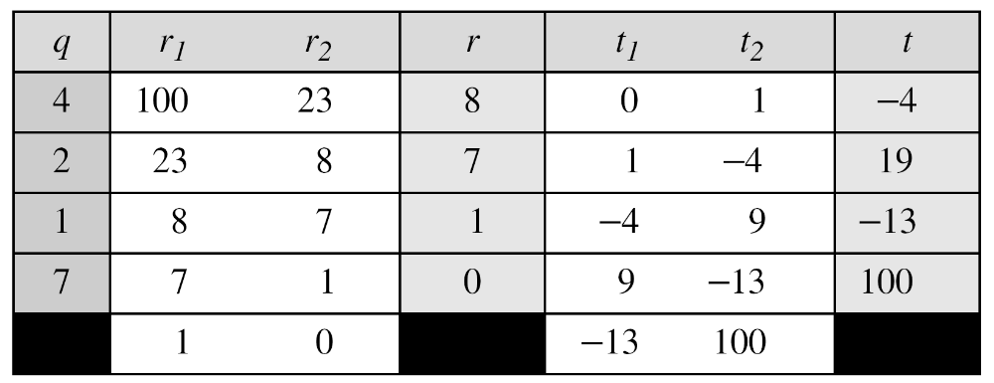
Extended Euclidean algorithm for multiplicative inverse (contd…)
Find the multiplicative inverse of 23 in Z₁₀₀.
The gcd (100, 23) =1; the inverse of 23 is −13 or 87.
B C Dhara, Dept. of IT, JU

Slide 59
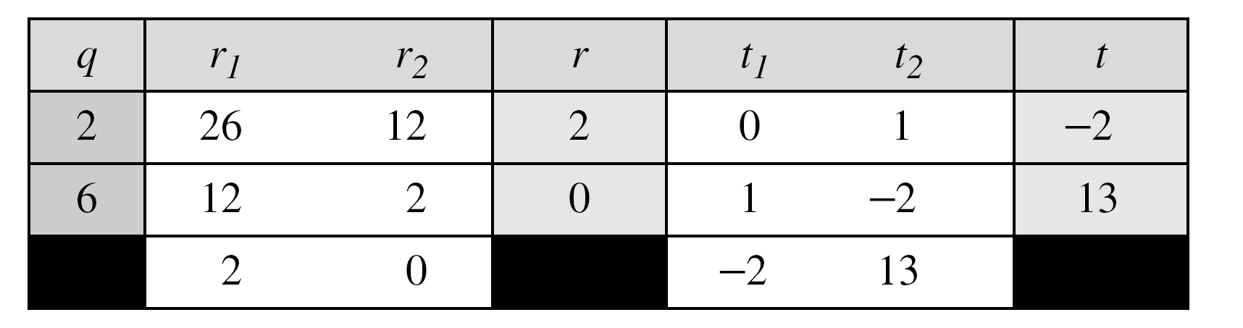
Extended Euclidean algorithm for multiplicative inverse (contd…)
Find the inverse of 12 in Z₂₆.
The gcd (26, 12) =2; the inverse does not exist.
B C Dhara, Dept. of IT, JU

Slide 60
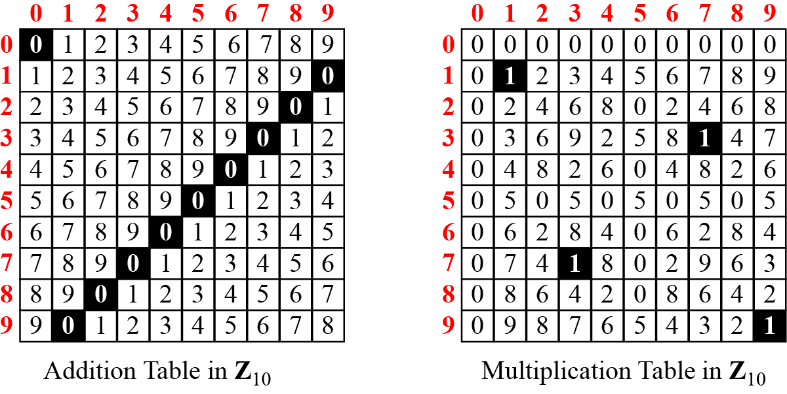
Addition and Multiplication Tables
B C Dhara, Dept. of IT, JU

Slide 61
Different sets
In cryptography very often inverse is used
  In decryption process inverse of the encryption key is used
If the operation is addition Z_{n} can be used as set of keys
When operation is multiplication, Z_{n} cannot be used as set of keys since some does not have multiplicative inverse
  We have to consider a subset Z_{n}* , which includes the integers that have inverse
B C Dhara, Dept. of IT, JU

Slide 62
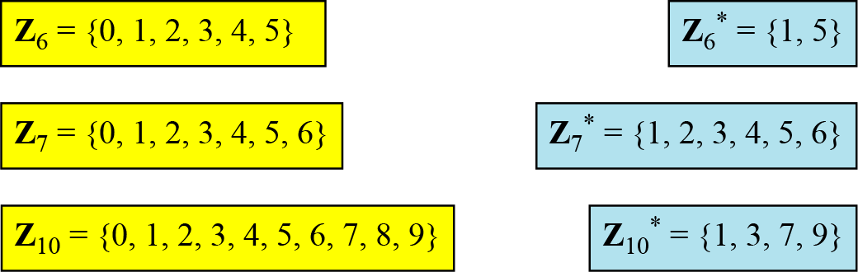
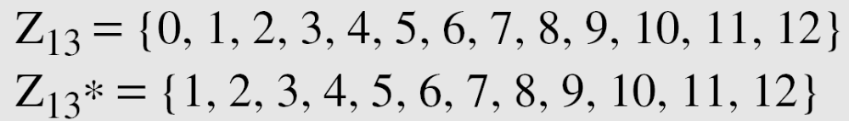
Different sets (contd…)
Cryptography often uses two more sets: Z_{p} and Z_{p}*, the number p is a prime number
  Z_{p} ={0,1,…,p-1} and Z_{p}*={1,2,…,p-1}
B C Dhara, Dept. of IT, JU

Slide 63
Matrices
In cryptography we need to handle matrices. Although this topic belongs to a special branch of algebra called linear algebra, the following brief review of matrices is necessary preparation for the study of cryptography.
B C Dhara, Dept. of IT, JU

Slide 64
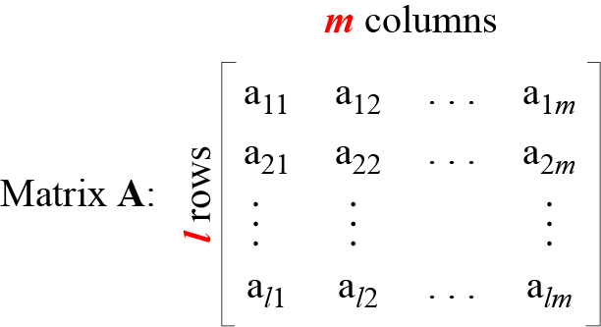
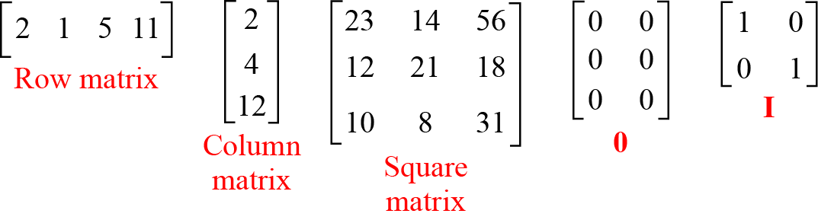
Definition
B C Dhara, Dept. of IT, JU

Slide 65
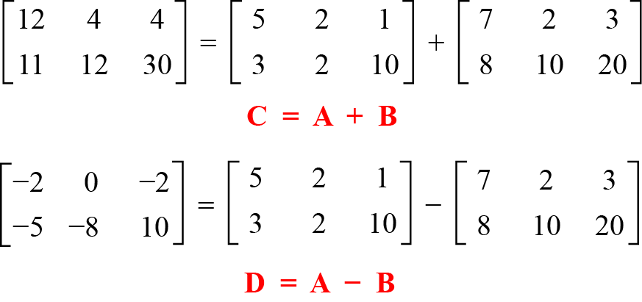
Operations and relations
Addition/subtraction
B C Dhara, Dept. of IT, JU

Slide 66
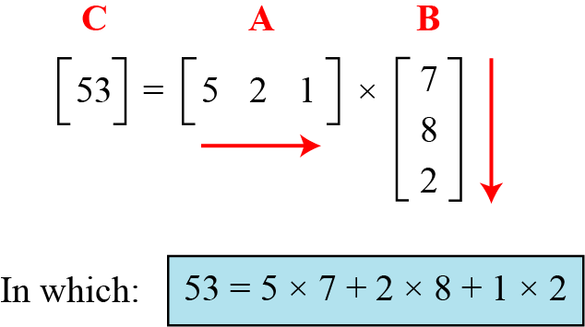
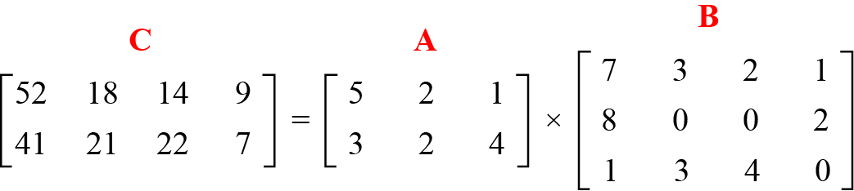
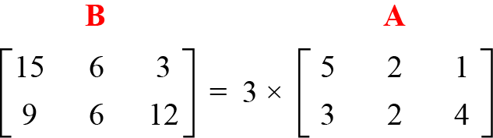
Operations and relations (contd…)
Scalar multiplication
B C Dhara, Dept. of IT, JU

Slide 67
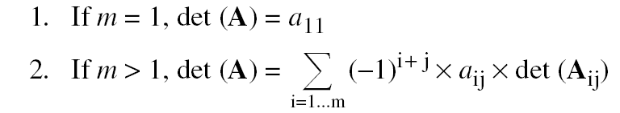
Determinant
The determinant of a square matrix A of size m × m denoted as det (A) is a scalar calculated recursively as shown below:
The determinant is defined only for a square matrix.
B C Dhara, Dept. of IT, JU

Slide 68
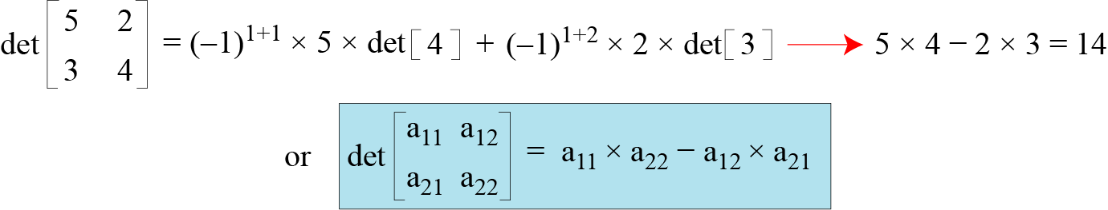
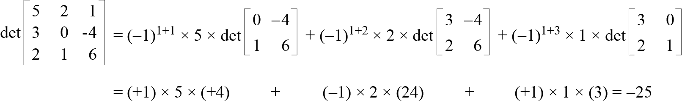
Determinant (contd…)
How we can calculate the determinant of a 2 × 2 matrix based on the determinant of a 1 × 1 matrix
B C Dhara, Dept. of IT, JU

Slide 69
Multiplicative inverse
Multiplicative inverse of a square matrix A is another square matrix B such that A× B = B× A = I
Multiplicative inverse exists only if det(A) ≠ 0
B C Dhara, Dept. of IT, JU

Slide 70
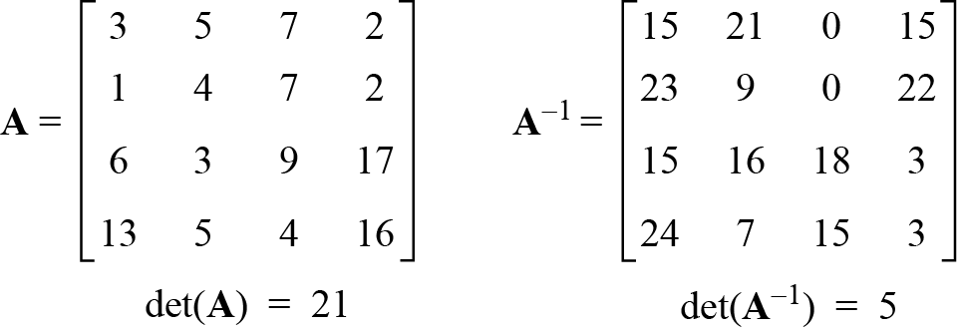
Residue Matrices
Cryptography uses residue matrices: matrices where all elements are in Z_{n}. A residue matrix has a multiplicative inverse if gcd (det(A), n) = 1
n=26
B C Dhara, Dept. of IT, JU

Slide 71
Congruence matrices
Two matrices are congruent modulo n, written as A ≡ B (mod n)
  If the matrices are of same dimension
  a_{i,j} ≡ b_{i,j} (mod n) for all i and j
B C Dhara, Dept. of IT, JU

Slide 72
LINEAR CONGRUENCE
Cryptography often involves solving an equation or a set of equations of one or more variables with coefficient in Z_{n}. This section shows how to solve equations when the power of each variable is 1 (linear equation).
  Single-Variable Linear Equations
  Set of Linear Equations
B C Dhara, Dept. of IT, JU

Slide 73



Single-Variable Linear Equations
Equations of the form ax ≡ b (mod n ) might have no solution or a limited number of solutions.
B C Dhara, Dept. of IT, JU

Slide 74
Single-Variable Linear Equations (contd…)
Solve the equation 10 x ≡ 2(mod 15)
  First we find the gcd (10 and 15) = 5. Since 5 does not divide 2, we have no solution
B C Dhara, Dept. of IT, JU

Slide 75
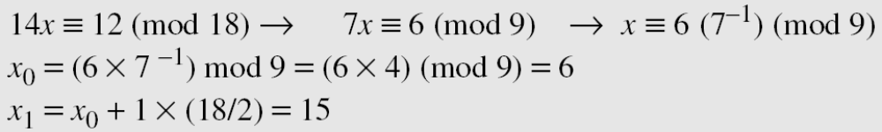
Single-Variable Linear Equations (contd…)
Reduce the equation by dividing both sides of the equation by d
  a₁x ≡ b₁ (mod n₁ )
  multiply both sides by a₁⁻¹ mod n₁ )and find particular solution x₀
  General solutions are: x = x₀ + k(n/d), 0≤ k ≤ d-1
Solve the equation 14 x ≡ 12 (mod 18)
B C Dhara, Dept. of IT, JU

Slide 76
Single-Variable Linear Equations (contd…)
Solve the equation 3x + 4 ≡ 6 (mod 13).
  First we change the equation to the form ax ≡ b (mod n).
  We add −4 (i.e. 9) to both sides
    3x ≡ 2 (mod 13)
    Because gcd (3, 13) = 1, the equation has only one solution, which is x₀ = (2 × 3⁻¹) mod 13 = 18 mod 13 = 5
  We can see that the answer satisfies the original equation: 3 × 5 + 4 ≡ 6 (mod 13).
B C Dhara, Dept. of IT, JU

Slide 77
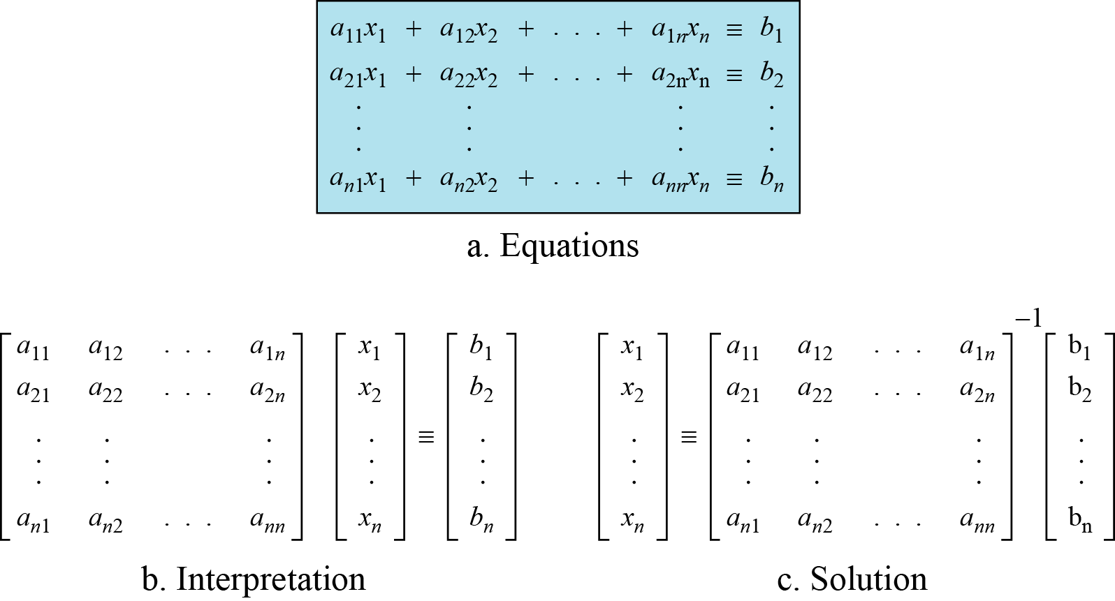
Set of linear equations
We can also solve a set of linear equations with the same modulus if the matrix formed from the coefficients of the variables is invertible
B C Dhara, Dept. of IT, JU

Slide 78
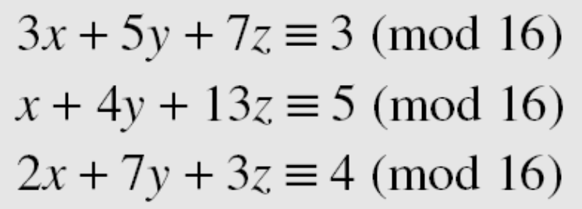
Set of linear equations (contd…)
Solve the set of following three equations:
A= det(A) mod 16 =15
  gcd(15,16)=1 A⁻¹ =
The result is x ≡ 15 (mod 16), y ≡ 4 (mod 16), and z ≡ 14 (mod 16)
3 5 7
1 4 13
2 7 3
14 11
9 5 0
1 11 9
B C Dhara, Dept. of IT, JU

